Slide 1


Automaton Theories of Human Sentence Comprehension
John T. Hale (2014)
발제자: 박기효
2020. 03. 15.

Slide 2
Chapter 8-9. Surpisal and Chunking + Conclusion

Slide 3
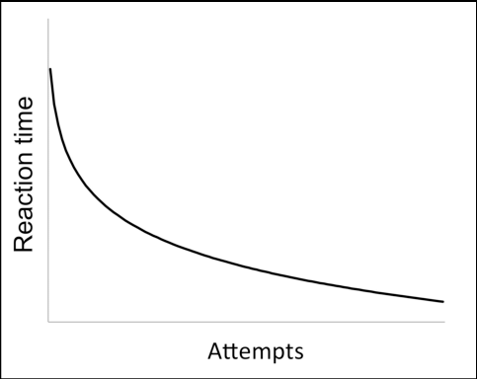
Introduction
- Chunking Theory of Learning (CTL)
1. Chuncking to account for the power law of practice – the logarithm of the reaction time
for a particular task decreases linearly with the logarithm of the number of practice
trials taken.
2. Language use as a highly-practiced skill
→ Ubiquitous frequency effects at all scales
The combination of CTL and Generalized Left-Corner pasing
→ To simulataneosurly explain:
i. How parsing happens.
ii. How it becomes frequency-sensitive.
iii. What its relationship to grammar is.

Slide 4
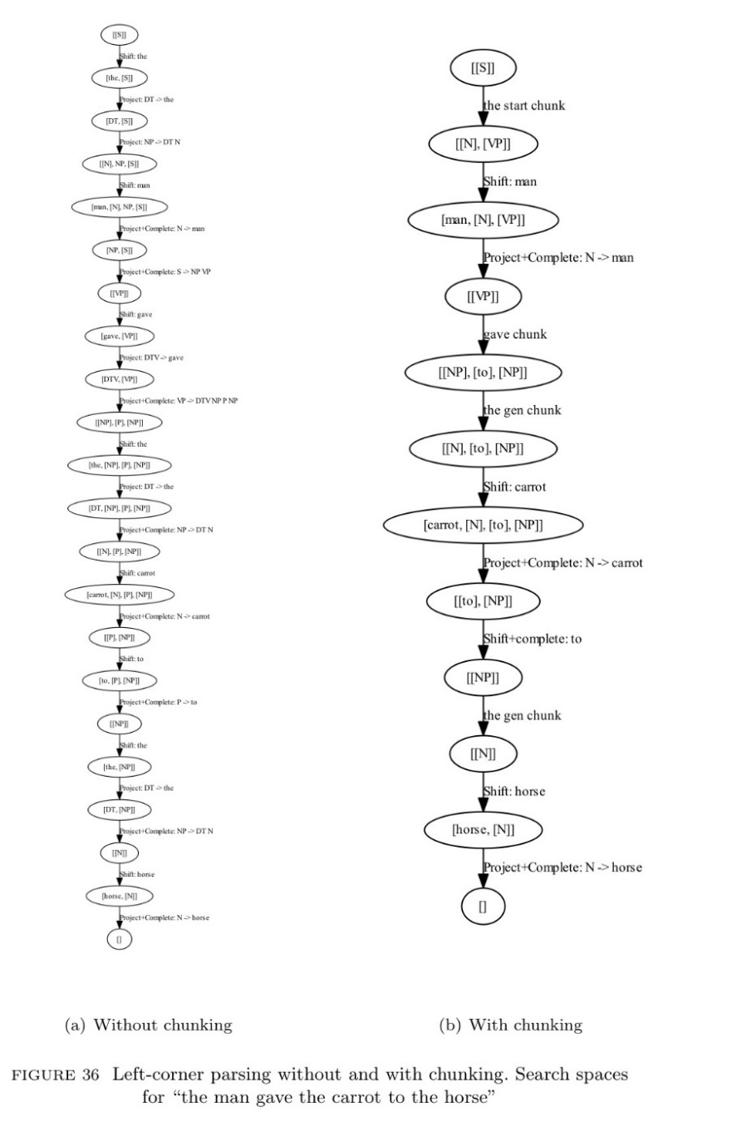
How chunking applies to parsing
- The CTL’s basic idea is that subtasks of a cognitive process
may be combined, yielding a new operator that excutes
more quickly than its components (Figure 36)
- This sense of chuncking is slightly different than the one in
ch. 5, where chunkcs recorded the outcome of decisions that
were made at choicepoints.
- In fig. 36, rather each chunk presents a new macro-operator
that combines several old operators into a single new one.
- With these macro-operators now available, the search space
is coarser (36(b)) than it was before (36(a)).

Slide 5
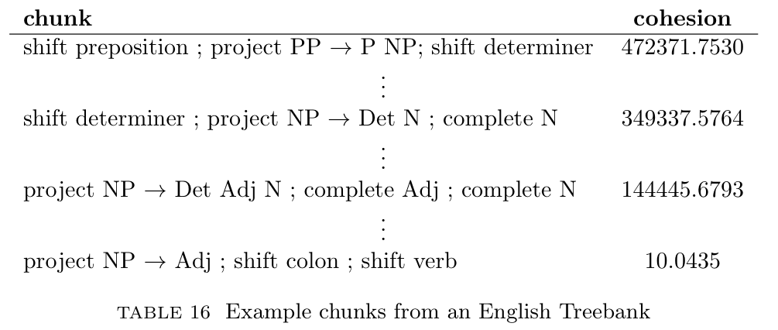
Identifying good chunks
- The example chunks in fig. 36 were motivated by intuitive notions of predictability.
- We can standardize the identification of good chunks by viewing a Treebank as a stream
of parser actions.
- In table 16, ‘cohesion’ give a log-likelihood ratio between the value that should have
been expected if each of the three parsing actions were (probabilistically) independent,
compared to the observed number of attestations of this triple.
- A parser-action tiple with high cohesion
is likely to become a macro operator
under CTL.
- Same results in French (Table. 17).

Slide 6
Reading faster when the chunk is familiar
- The CTL explains speedup due to practice in terms of new mental representations:
Performance Assumption
The performance program of the system is coded in terms of high-level chunks, with the
time to process a chunk being less than the time to process its constituent chunks.
- While the exact threshold between having a chunk and not-having chunk will depend on
the details of a particular algorithm, what is clear is that parser-action triples with
higher cohesion values are more likely to get chunked.
- If a human reader is using the chunks rather than the individual component GLC parsing
actions, it should be read faster under the CTL performance assumption.
- To evaluate this idea, we used linear regression to predict eye-fixation durations in
eyetracking copora.

Slide 7
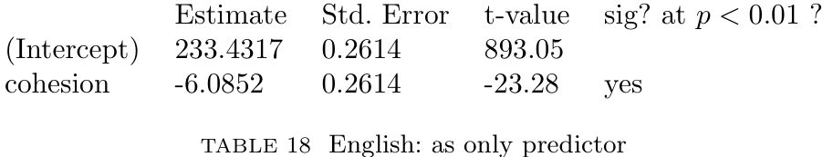
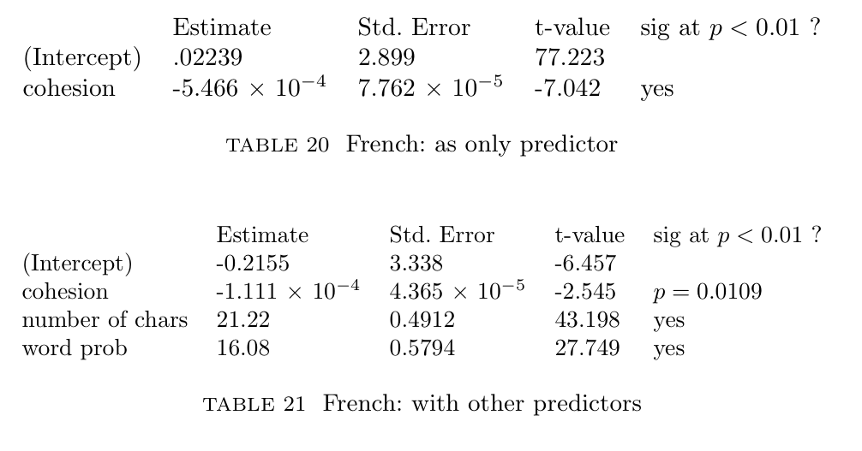
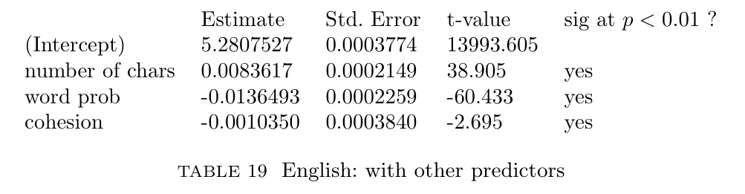
English & French study

Slide 8
Discussion
- These two studies lend support to the idea of chunks as psychologically real sequences of parser actions that make reading go faster.
- Via the CTL, one can say that constructions get stronger with usage, while at the same time interpreting them with respect to particular rules of a generative grammar.
- An important tradition in computational linguistics has considered larger chunks of phrase structure as grammatical entities.
- The approach taken here, inspired by the CTL, is different in that the chunking happens at the level of parser actions rather than the grammar.

Slide 9
Discussion
- Although the results are promising, many questions remain open. One is mathematical in nature:
How suprsials change
For a given probabilistic grammar G, choose a canonical transistion machine M(G) that
assigns the same probabilities as G does to its language, L(G):
1. How do the surprisal values assignend to sentences in L(G) change with the addition,
via chunking, of additional transitions summarizing sequences of previously-extant
transitions?
2. How should renomalization take place to ensure that the probability model remains
well-defined?
3. How quickly does the distribution assigned by the transition-based representation
start to diverge from that assigned by G?

Slide 10
Discussion
- Another more developmental question has to do with:
Lifetime exposure
- If language comprehension is really a procedural skill that gets tuned by use, then we
should expect that the number of times a person has heard a construction in a given
context should predict the amount of time it takes him or her to comprehend.
- Evaluate this claim using longitudinal data to estimate as precisely as possible the
number of times that individual children have heard particular constructions that are
within, or proximal to their linguistic competence.

Slide 11
Conclusion (Ch. 9)
- The automaton view laid out in this book is menat to bridge tha gap: How do grammar
and parser interrelate?
- The proposed answer is that a grammar rule should label the name of a structure-
building action.
- The automaton’s transition causally does something, whereas the grammar rule
interprets the linguistic significance of that action.
- Remainig (particular) questions:

Slide 12
Conclusion (Ch. 9)
- Remainig (particular) questions:
1. Which grammar is the right one?
- One might imagine that data on language behavior could reach back up through a
formalized theory of performance to help linguists decide which grammar is the right
one.
- One some level this is true, but it also invites a category mistake.
- The empirical finding that a parituclar construction is easy rather than hard does not
speak to the raw possibility of that construction in a language, which does not speak
to the relationship between the construction and the its typological cousins on other
languages.
- The true bite of the automaton view is the proposal that individual rules are the right
granularity for processor operators, which is an attractive opening bid as it keeps
things simple.

Slide 13
Conclusion (Ch. 9)
- Remainig (particular) questions:
2. Neural realization
- What does it mean for a grammatical relation to be “tokened” in the mind?
- What brain-state transitions are characteristic of a comprehension episode?
- These questions, about the physical basis of syntactic distintions, are analogous to
phonetic questions about the physical basis of speech sounds.

Slide 14
감사합니다!

